Slide 1













Team Name: RAG Retrievers
Team Leader Name: Arunkumar K R
Statement : AI PDF Routing System

Slide 2

PROBLEM STATEMENT
Organisations receive large volumes of PDFs (complaints, applications, notices, requests)
Manual reading + routing causes:
Delays
Human errors
Operational cost
Missed or ignored documents

Slide 3
PROPOSED SOLUTION
What exists today
Manual email sorting
Rule-based keyword filters
Basic OCR tools
Manual reading + routing causes
Delays
Human errors
Operational cost
Missed or ignored documents
Our solution
Upload any PDF (digital or scanned)
Extract and clean text using OCR + AI
Generate a concise, intent-based summary
Automatically route and email to the correct department

Slide 4
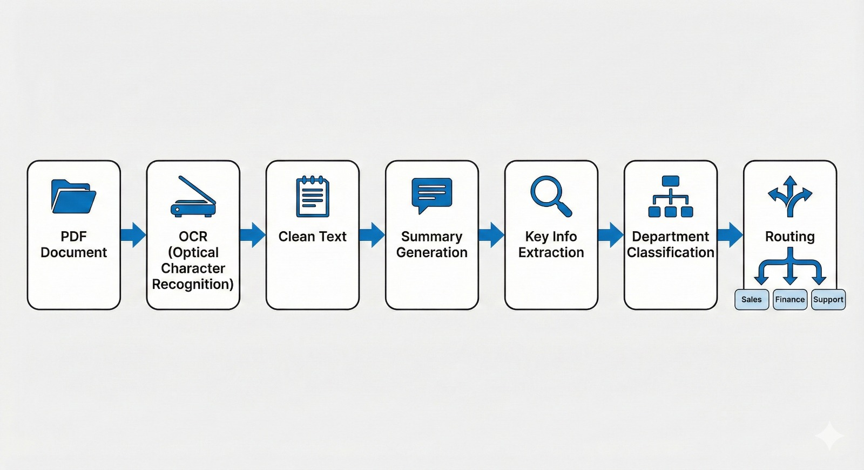
SYSTEM ARCHITECTURE

Slide 5







SDGs

Slide 6
THANK
YOU

